Slide 1
PS 6 Matching Models
Ayse, Prachi, Yunus & David

Slide 2
Introduction
Kaggle is an online platform for data science competitions.
Hosts high-payout contests and awards Kaggle Points, which often serve as professional credentials or portfolio highlights.
Features a diverse user base, ranging from beginners to expert data scientists.
Our approach follows the revealed-preference matching literature:
Hitsch, Hortaçsu, and Ariely (2010) — Review of Economic Studies
Akkus, Cookson, and Hortaçsu (2016) — Management Science
Chan, Chen, and Wu (2023) — Journal of Political Economy Microeconomics
Lemus and Marshall (forthcoming) — Review of Economics and Statistics

Slide 3
Data
We utilized the Teams, TeamMemberships, Users, UserOrganizations, and UserAchievements tables to analyze team formation
User attributes include country, organization, and experience score (derived from points and ranking).
Across roughly 26 million Kaggle participants. 8.3 million instances of joined teams (actual participation). Of these 3.2 million were unique users.

Slide 4
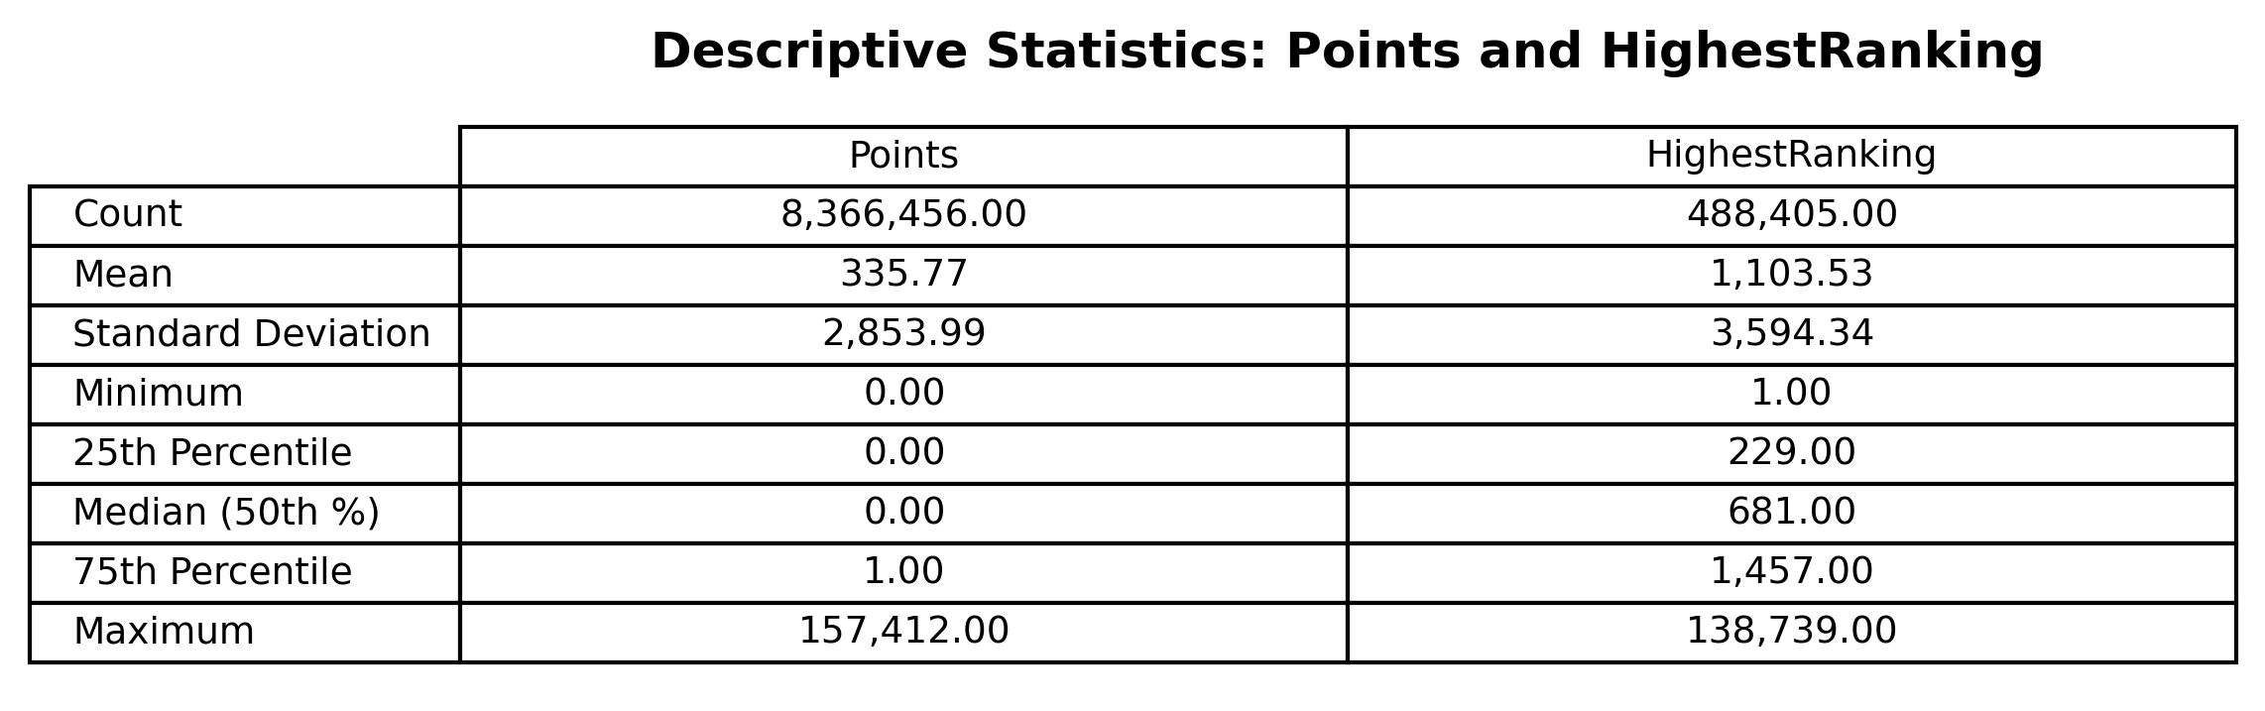
Descriptive Statistics

Slide 5
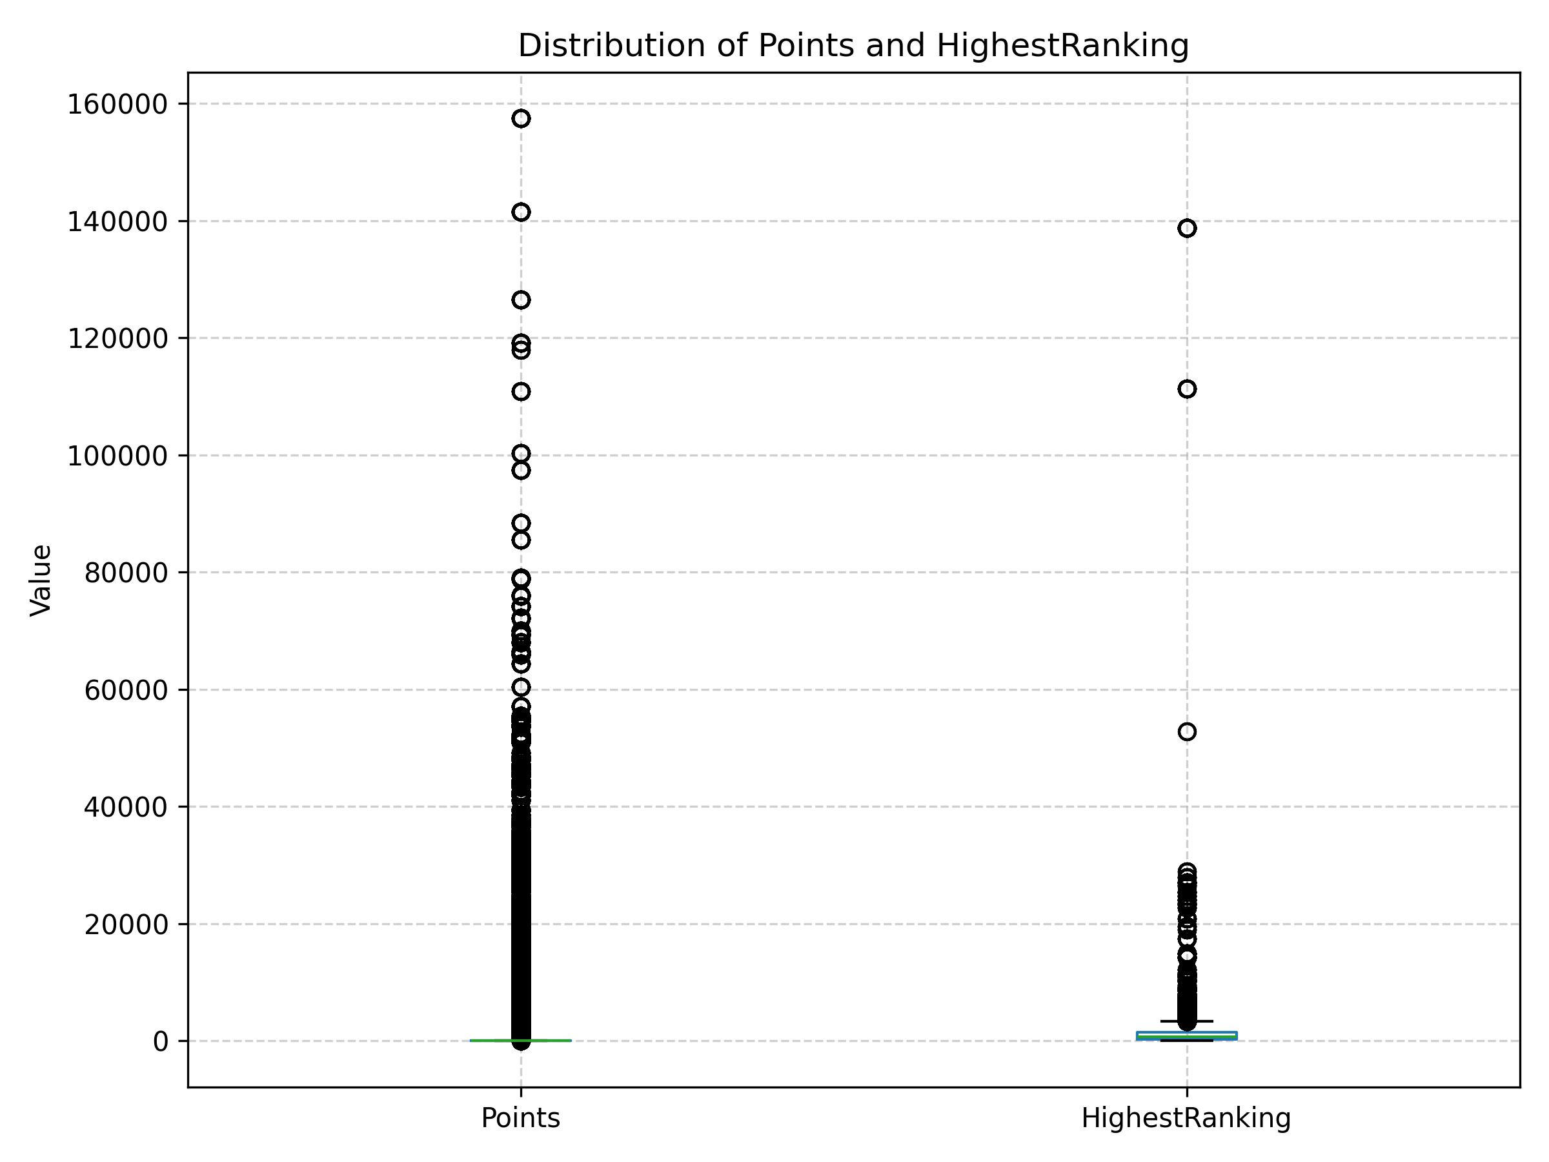
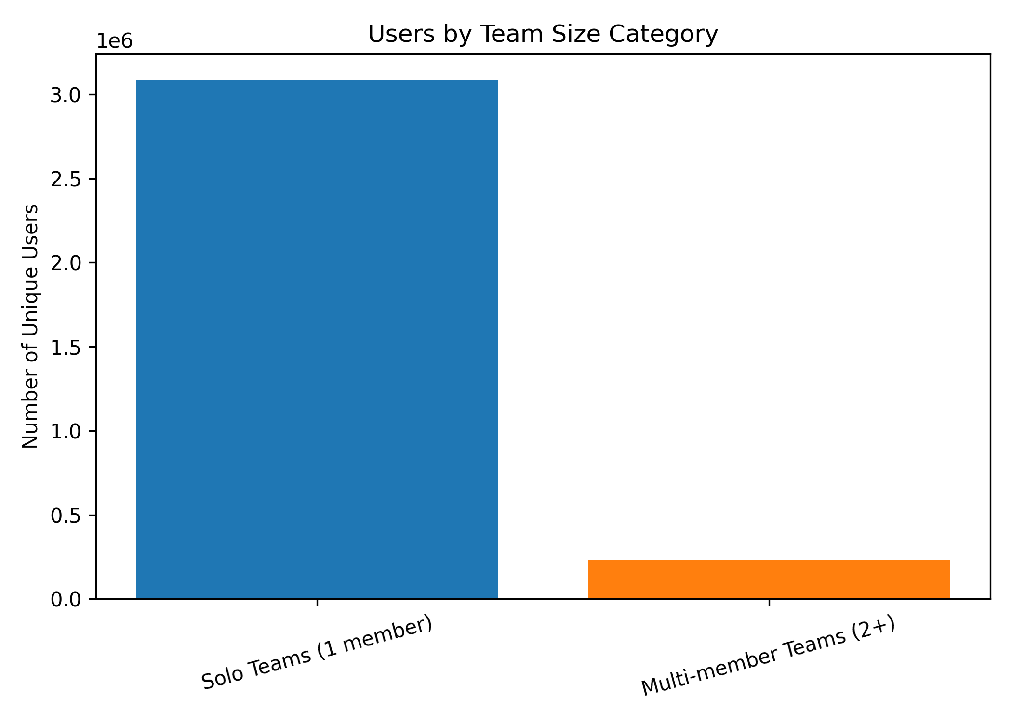
Summary Statistics for Points & Highest Ranking

Slide 6
Filtering
Due to noisy data and low/non performers we introduced a number of filters for our data to isolate only teams seriously contending for prize award.
We restricted our dataset only to those teams that had at least 2 points or reached the median highest ranking of 681. (Sorry Prachi).
As points decay over time we will utilize highest ranking and tier as our proxy for experience. This data is also available publicly so potential team members would be able to view this when making their decision about whether or not to join a team.

Slide 7
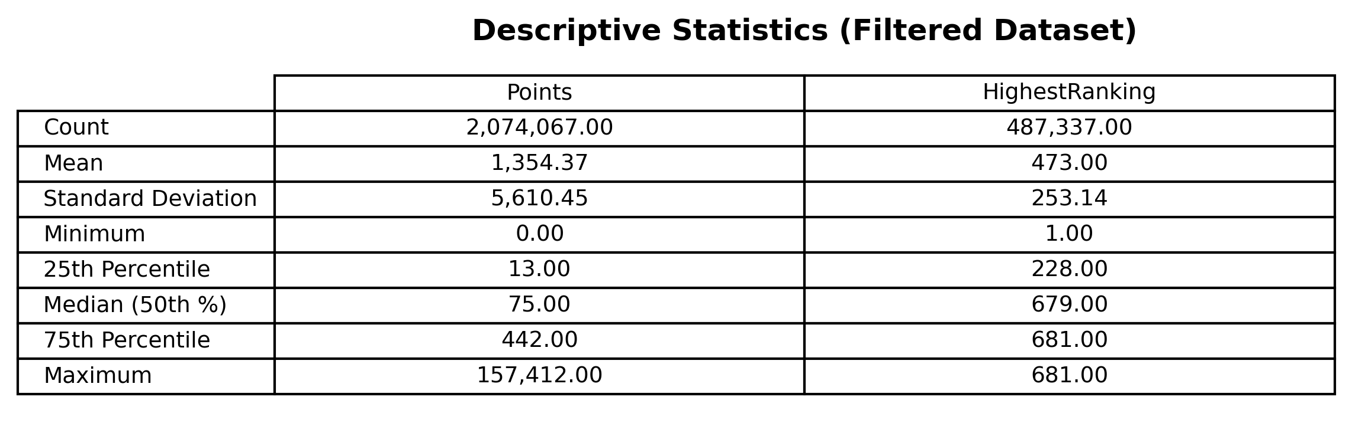
Descriptive Statistics Filtered

Slide 8
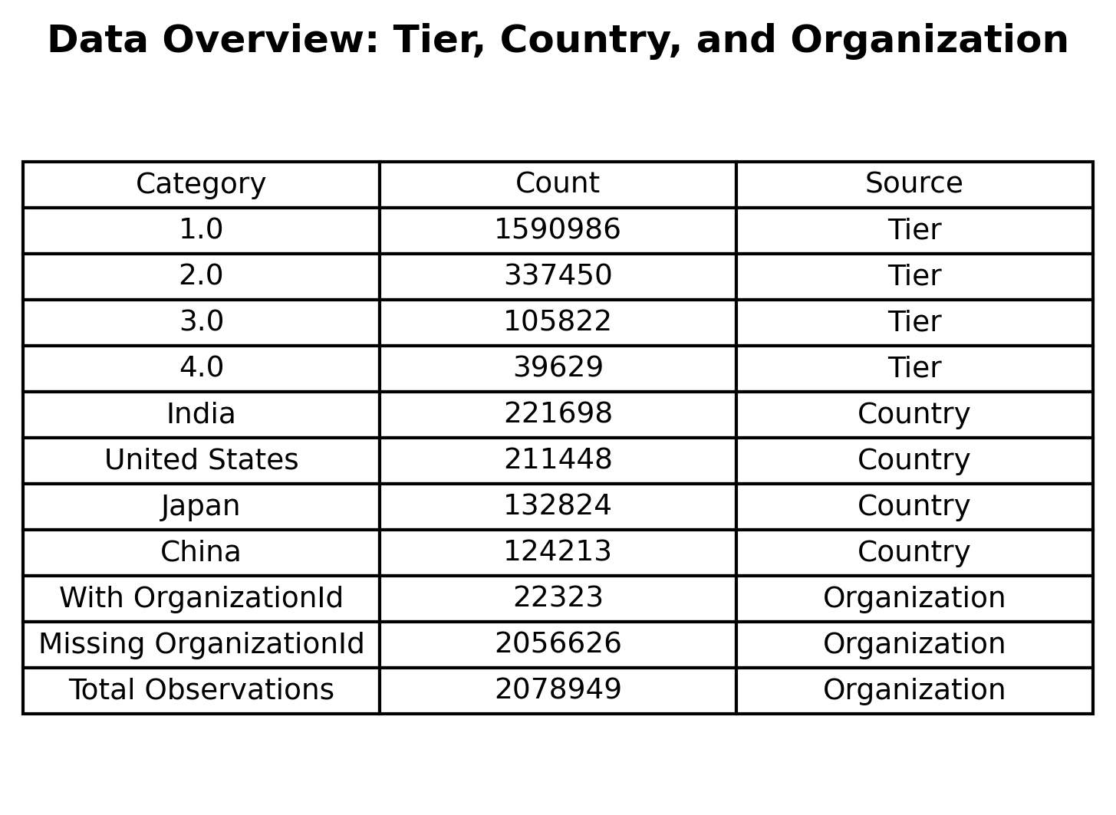

Slide 9
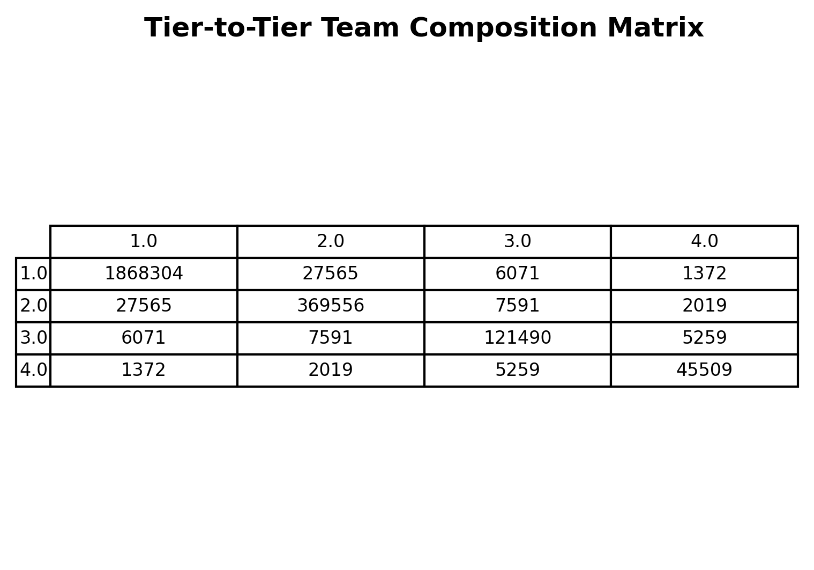

Slide 10
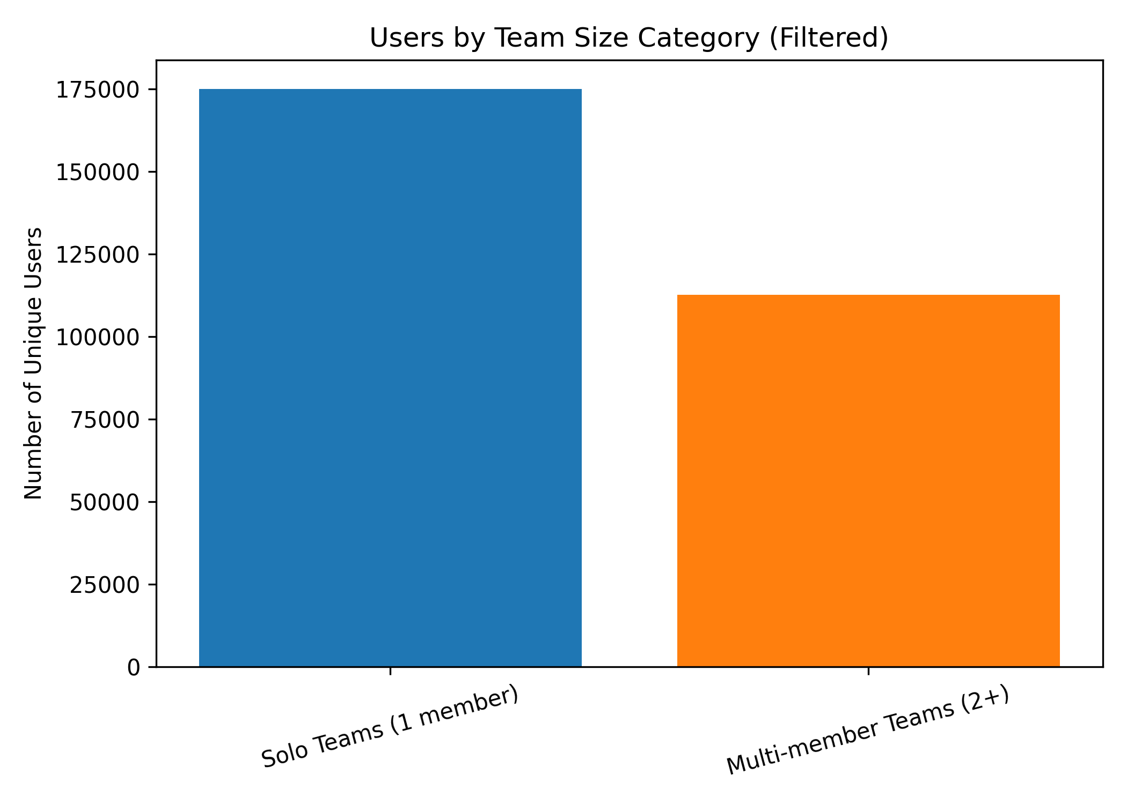
Teamsize Filtered
After filtering the data there is a much larger percentage of 2+ person teams for high performers.
Team submissions are counted for each contest separately so users can choose to join a team in 1 competition as solo, then later join a team and still be preserved.
In addition this will be helpful in gathering insight from our MSE on what factors cause team formation and the stickiness of that decision

Slide 11
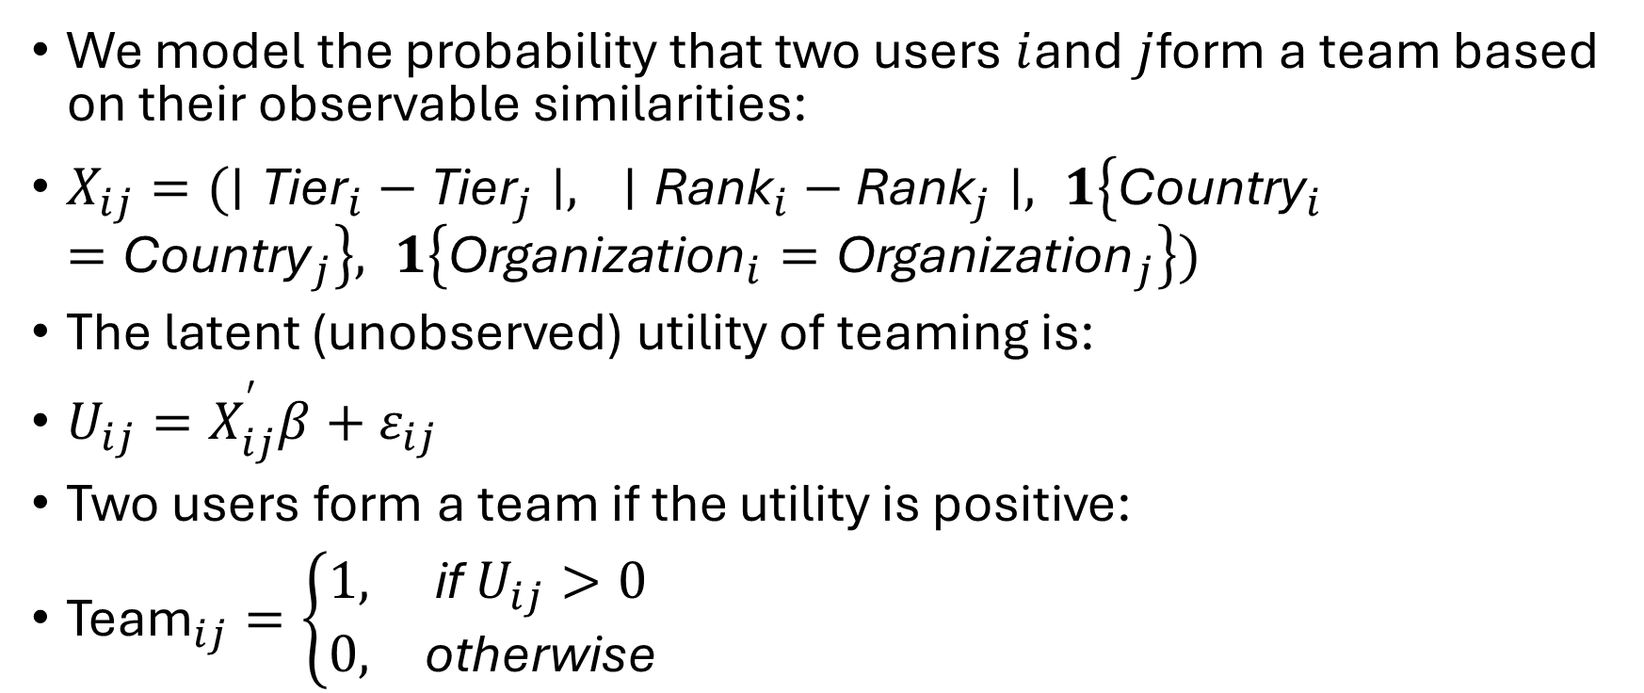
Model
We model the probability that two users $i$and $j$form a team based on their observable similarities:
$X_{ij}=(∣{\text{Tier}}_{i}−{\text{Tier}}_{j}∣, ∣{\text{Rank}}_{i}−{\text{Rank}}_{j}∣, 1\left\{{\text{Country}}_{i}={\text{Country}}_{j}\right\}, 1\left\{{\text{Organization}}_{i}={\text{Organization}}_{j}\right\})$
The latent (unobserved) utility of teaming is:
$U_{ij}=X_{ij}^{′}β+ε_{ij}$
Two users form a team if the utility is positive:
${\text{Team}}_{ij}=\left\{\begin{matrix}1, & \text{if} U_{ij}>0 \\ 0, & \text{otherwise}\end{matrix}\right.$

Slide 12
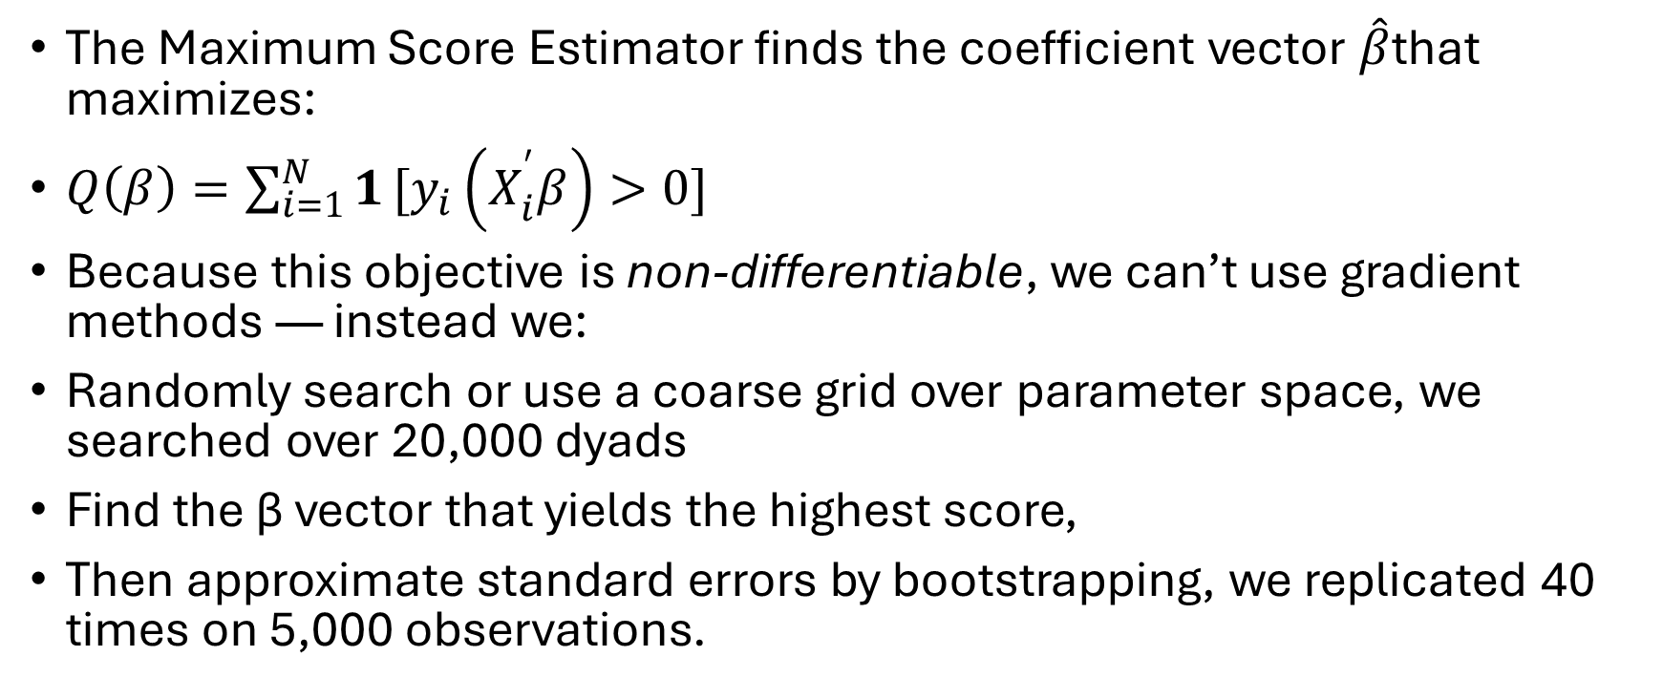
Estimation Approach: Maximum Score Estimator
The Maximum Score Estimator finds the coefficient vector $\hat{β}$that maximizes:
$Q\left(β\right)=\sum_{i=1}^{N}{1}[y_{i}\left(X_{i}^{′}β\right)>0]$
Because this objective is non-differentiable, we can’t use gradient methods — instead we:
Randomly search or use a coarse grid over parameter space, we searched over 20,000 dyads
Find the β vector that yields the highest score,
Then approximate standard errors by bootstrapping, we replicated 40 times on 5,000 observations.

Slide 13
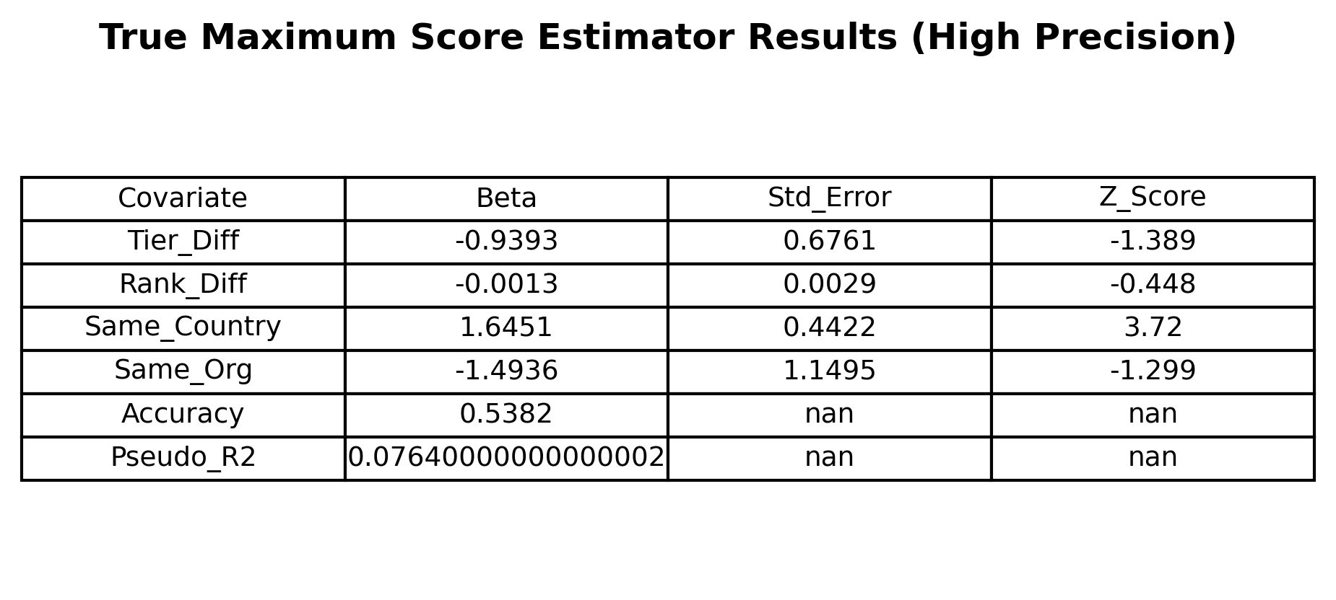
Results

Slide 14
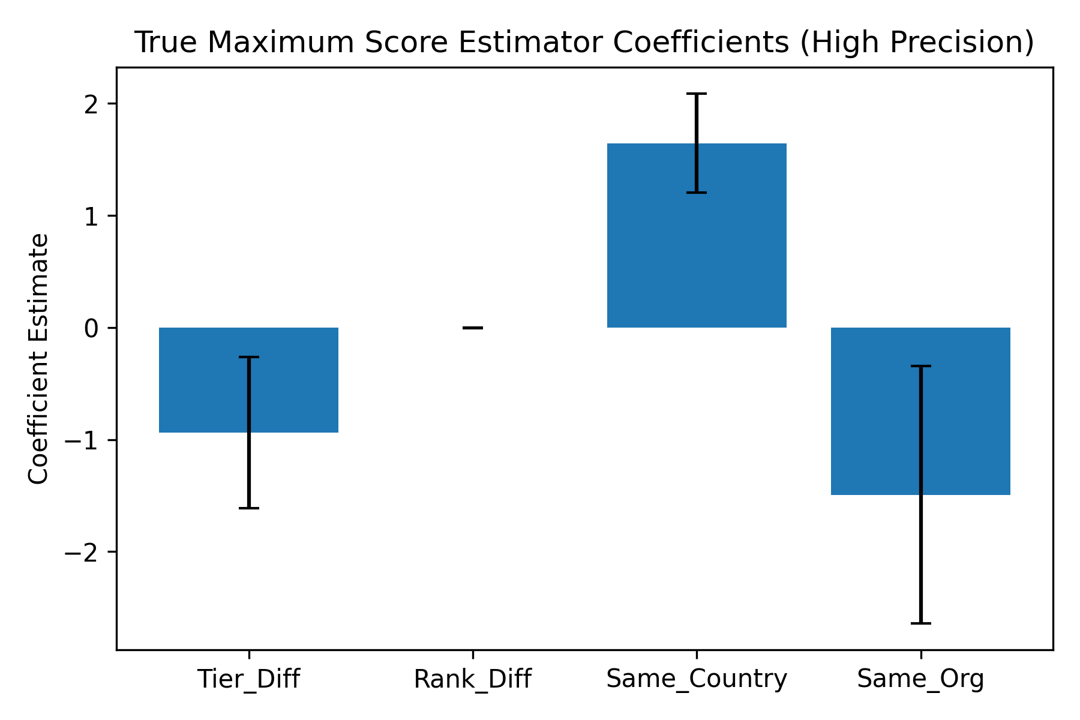
Results

Slide 15
Summary / Interperetation
Skill Difference and Country were our largest predictors of team formation.
Same Org. had a very large negative coefficient surprisingly, suspect due to the large number of missing observations in the data.
Teams most likely to form within Tier

